Slide 1
The Implementation of Customer Relations Management and GPS Tracking Software For Business
Compiled and Presented by:

Slide 2
Background Information
X-M Inc. has reported a 15% decline in sales and 25 % decline in net profits in the past fiscal year.
The market share has declined by 25% and customer numbers are on a downward trend
There have been numerous customer complaints due to poor customer service by staff
The number of cancelled orders has increased significantly due to delays in delivery of products and low turnaround time
Hence, the company should improve its customer retention by use of customer relations management and sales revenues by tracking transport of customer goods to the final destination.
This presentation highlights the technological capabilities and advantages of incorporating the CRM software and GPS tracking systems in the business.
Notes:
Companies have endeavored to uphold their positions in the corporate world, competition has intensified as new firms are gaining entry into existing markets, and the launch of new products with fairly high and low prices (Paper Mok, & Rodger, 2004).
The impact has been felt by the existing companies with mature products in the markets.
But, it is apparent that all firms strive to preserve their markets share and are predisposed to implement and adjust to new production systems and wider application of IT in the production processes.
It is valuable that the new products tend to have substantial effects on the forces of supply and demand in the markets (Gelinas, Sutton & Fedorowicz, 2008). Added, the IT that incorporates telecommunication, software applications, and hardware creates powerful brands and corporate image that can make the firm retain its markets share, market position and overall profitability.

Slide 3
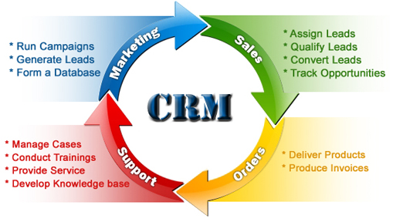
Customer Relations Management
Notes:
Customer Relationship Management is a software solution that delivers a host of technological capabilities together as the software allows the firm to store all prospects and existing customers, make phone calls, generate reports, schedule customer appointments, send emails, add notes, manage the pipeline (Kumar & Reinartz, 2017).

Slide 4
Three phases of CRM
Acquisition of New Customer Relationships
  The business will acquire new customers by promoting its products and services leadership.
Enhancing the Existing Customer Relationships
  The relationship can be enhanced by encouraging distinction in up-selling and cross-selling, thus deepening and augmentation of the relationship.
Retaining the Customer Relationships
  Customer retention emphases on service adaptability by delivering not what the markets needs but what the customers want.

Slide 5
The CRM technical specs
Software on the server/cloud
For your desk and on the go
A tool that supports integrations
Notes:
The CRM systems were originally hosted on the physical servers, but today they are increasingly shifting to cloud storage. So, the business can buy the CRM software on subscription basis and customize the software. This eliminates the server management costs
CRM systems are mostly web-based software applications. They are developed predominantly for PCs and laptops, but today the CRMs are also optimized for handheld devices as mobile apps on the Android and iOS platforms (In Eid, IGI Global, & IRMA, 2017).
CRMs can be integrated with various applications such as marketing automation tools, helpdesk software, and live chat software which allows for swift and real time collaborations.

Slide 6
Benefits of using CRM software
Enhanced relationships with customers
Lesser data entry
Better communication
Healthier pipelines
Higher revenue
More collaboration = a strong business
Notes:
The CRM system will bring all customer information into one interconnected unit. The complete history of the customer with the business exists together with a list of potential deals; emails, key notes, and engagements live in one huge interface. The fact that real-time notifications can be gotten when customers perform significant activities—like visiting the Pricing page, making orders online or clicking on a link in the email. This presents a goldmine of valuable information availed in one system and under one roof.
Therefore, CRM is a one-stop shop for the sales teams and it can be the main difference between sealing a big deal and losing the deal. It can be the gateway to augmented sales productivity, healthy pipelines and increased coordination between and beyond teams. At the core of the CRM software is building lasting relationships with the customers.

Slide 7
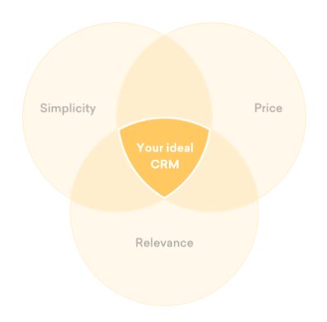
Choosing the right CRM for
X-M Inc.
Simplicity
Price:
Relevance
Notes:
Important pointers of simple CRM software include intuitive user experience, clean interface and minimal time necessary to get started.
Price entails hidden costs like maintenance and implementation costs
Relevance entails choosing the ideal CRM that supports and solve the business case. The company goals, strategies, and objectives should be clearly defined.

Slide 8
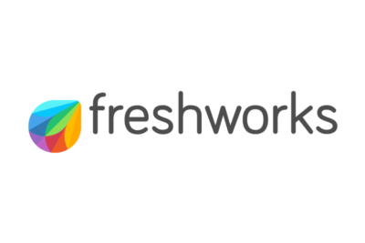
Recommended CRM Software

Slide 9
GPS Tracking for Delivery Vehicles
GPS vehicle tracking end-to-end solutions are designed for companies to take full control of the fleet and help in the assignment of faster routes (taking into account traffic), to ensure that the fleet takes the most efficient routes possible to the destination.
The real time fleet tracking will allow the company to offer accurate ETA’s to the customers for deliveries. Customers certainly appreciate faster and accurate deliveries which would be the company’s competitive edge

Slide 10
Benefits of GPS Tracking Software
Boost productivity as the employee hours are monitored and more delivery stops in one day
Promote safer driving, safer fleet and fosters professionalism
Improve customer satisfaction and customer retention due to timely deliveries
Planning the most efficient routes lowers fuel and labor costs (overtime hours)
Lower costs in the end increases the bottom line
Notes:
Delivery is lucrative yet challenging for business especially for firms that have online order platforms (Burgess, S. (2002). Apart from monitoring a huge fleet of vehicles and drivers for safety, there is need to protect the merchandise that the vehicles are carrying. GPS for tracking the fleet is just the perfect and low-cost solution to ensure that the business is efficient.

Slide 11
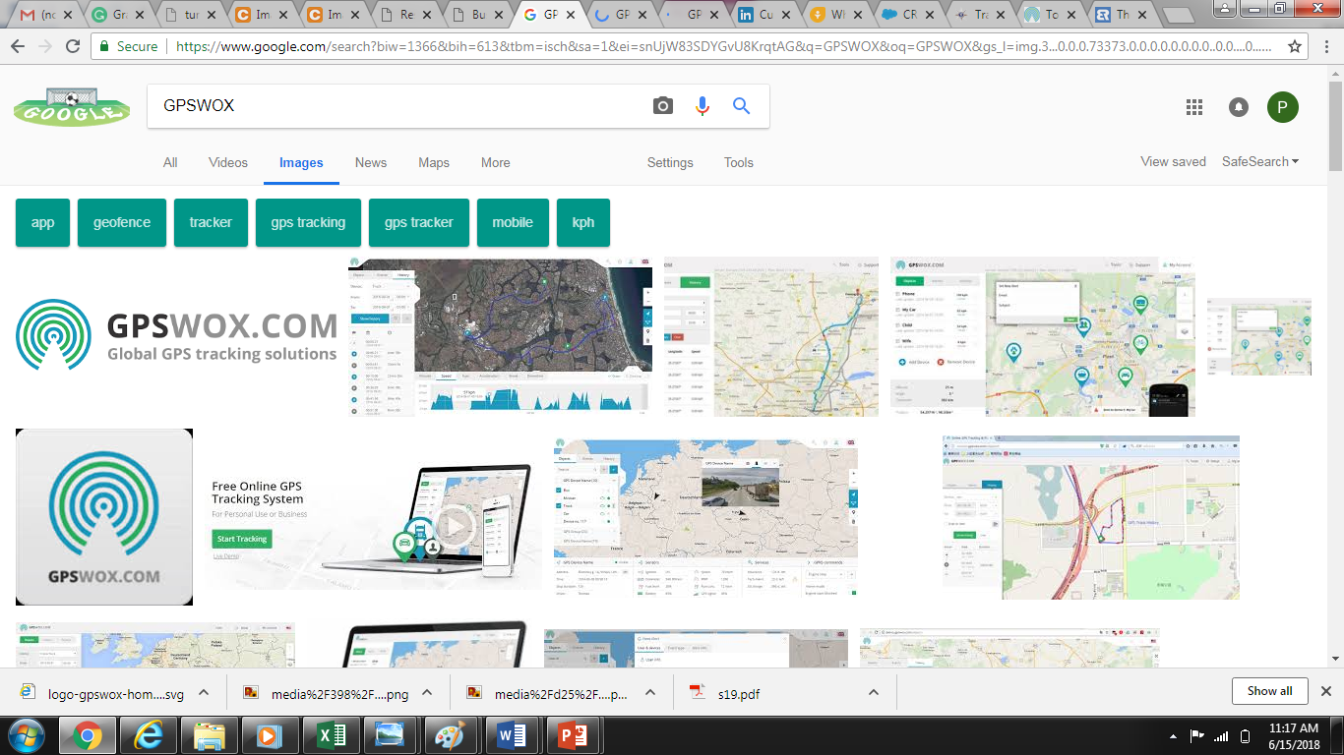
Technological Capabilities
One Main Administration Account
Real time and multiple device tracking
Worldwide Coverage and 24/7 international technical Support
Detailed Reports in different formats
Geo-fence Alerts
Connect any GPS tracker and track it online
Mobile tracking apps: Android and iOS
Tracking objects: vehicles, motorbikes, mobile phones, person, goods
99.99% server uptime guaranteed
Notes:
Tracks the location of objects (vehicles, drivers, mobile, motorbike) online in real-time via Google, Satellite, and OSM. Additional information on the tracking include speed of vehicles, exact address, fuel consumption, and travel history
Get prompt notifications on mobile devices, such as texts e-mail, or mobile App.
Instant alerts and about the tracking object such as knowing when objects enter or exit the geo-zone, speeding and even stopovers. SOS alarms can be generated if the car or goods are stolen and turning on/off engines easily.
Download and generating detailed reports in diverse formats on information by dates and GPS tracker: driving hours, speed, stopovers, distance, fuel consumption and others.
The Geofence feature permits setting up geographic boundaries in areas that have explicit interest for the business. Automated alerts are sent when objects enter or leave marked boundaries.

Slide 12
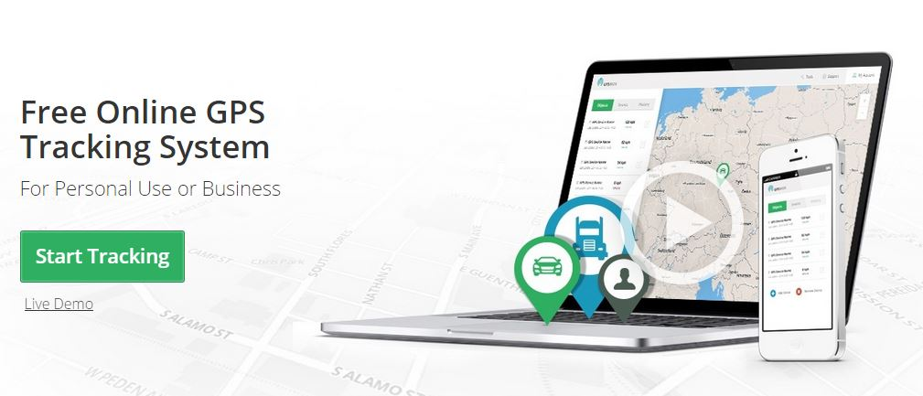
Recommended Tracking Software: GPSWOX

Slide 13
The End
Q & A Session

Slide 14
References
Burgess, S. (2002). Managing information technology in small business: Challenges and solutions. Hershey, Pa: Idea Group
Paper, D., Mok, W., & Rodger, J. (2004). Building automation into existing business processes. Hershey, PA: Idea Group Pub Bottom of Form
Gelinas, U. J., Sutton, S. G., & Fedorowicz, J. (2008). Business processes and information technology. Gainesville, Fla.: Orange Grove Texts Plus.
In Eid, R., IGI Global,, & Information Resources Management Association,. (2017). International journal of customer relationship marketing and management (IJCRMM): Volume 8, issue 4.
Kumar, V., & Reinartz, Werner. (2017). Customer Relationship Management: Concept, Strategy, and Tools. Springer Verlag.

